Slide 1
Kansas City International Airport Terminal Presentation #2 Midland Consulting Blake Conrad, Bonnie McIlrath, Cathy Miller, Doug Serota, and Shaun Wild
Briefing to Dr. Deandra Cassone
30 October 2017

Slide 2
Agenda
Background.
Alternatives.
Raw Data.
Approach.
TOPSIS results.
Way Ahead.

Slide 3
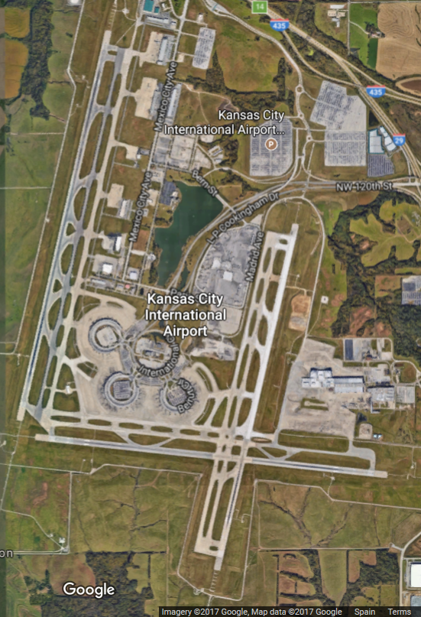
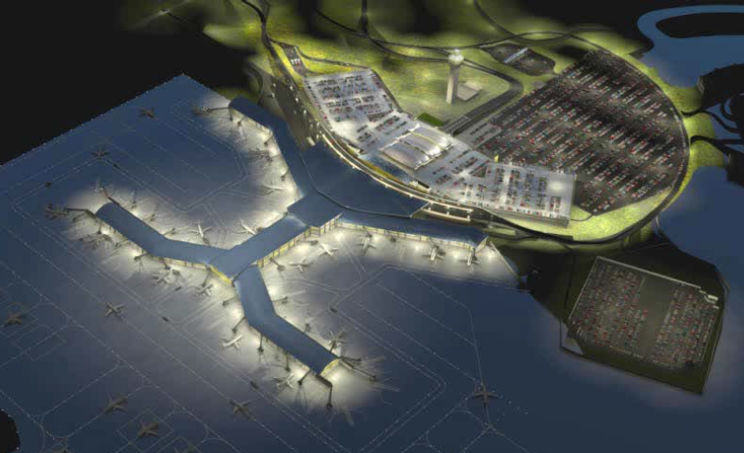

Background
Objective: Select a design for the new “terminal that enhances the role of Kansas City in providing a high level of air service, as well as a source of community pride for Kansas City and the region.”
Current Terminal Design
Example Future Terminal Design
http://www.flykci.com/media/1177/citycouncil-4-4-13-final-edited-not-complete.pdf
2018
KCI rebuild goes to the voters.
30 October 2017
Select approach
Identify alternatives
Collect data
Run model
4 December 2017
Conduct sensitivity analysis
Provide final results
https://www.google.com/maps/@39.3045812,-94.722442,6211m/data=!3m1!1e3?hl=en-US.
Selection Committee Decision Support Team
25 September 2017
Identify the problem
Develop objective weights
Identify decision criteria
Midland Consulting
Blake Conrad
Bonnie McIlrath
Cathy Miller
Doug Serota
Shaun Wild

Slide 4
Alternatives
(1 of 2)
Contractors were asked to submit terminal design proposals that met the following specifications:
750,000 square foot single terminal facility
35 “Airport Design Group” III compliant gates
Expansion potential
6,500 space, multi-level parking structure adjacent to terminal
Two-level terminal
Separate commercial and passenger curb areas
Estimated annual repayment of $69.33 million (FY22 dollars)
Total construction cost Not To Exceed $975M (FY15 dollars)
Contractors submitted four terminal design alternatives:
Two designs met specifications.
Two designs did not meet specifications but provide reduced capital and operating expenses based on analysis of “opening day” need.
We retained all four options, as each of them met at least one or more of the major criteria.
Source: Memorandum of Understanding Terminal Modernization Program

Slide 5
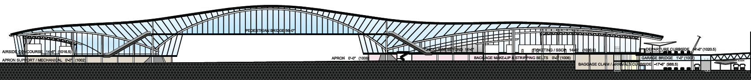
Alternatives
(2 of 2)
Option 1. Functional, Compliant – 35 Gates
Option 3. Functional, Reduced Compliant – 25 Gates
Option 2. Iconic, Compliant – 35 Gates
Option 4. Iconic, Reduced Compliant – 25 Gates
Source: KCI Partnership Request for Qualifications/Proposals for Design, Construct, and Private Financing of KCI, Section F: Financial Approach

Slide 6
Raw Data
Sub-Objectives | Decision Criteria | Metrics | Benefit or Cost Attribute | Functional Compliant 35 | Iconic Compliant 35 | Functional Reduced 25 | Iconic Reduced 25
1. Terminal Interior. | 1.1 Layout. | Departure Flow. | Benefit | 4.25 | 4 | 4.25 | 4
 |  | Arrival Flow. | Benefit | 4.5 | 4.25 | 4.5 | 4.25
 | 1.2 Security. | Security Lanes. | Benefit | 11 | 12 | 11 | 12
 |  | Security Design. | Benefit | 4.5 | 4.25 | 4.25 | 4
 | 1.3 Customer Experience. | Terminal Sqft. | Benefit | 750000 | 738247 | 653279 | 657745
 |  | Restrooms. | Benefit | 77 | 56 | 49 | 49
 | 1.4 Flexibility. | Gates. | Benefit | 35 | 35 | 25 | 25
 |  | Expan. Potential. | Benefit | 4 | 3.5 | 3.75 | 3.5
 | 1.5 Airlines. | Airline Ops Sqft. | Benefit | 265408.4 | 204436.3 | 237508.4 | 171436.3
 |  | Baggage Handling. | Benefit | 7 | 3 | 7 | 3
2. Air Ops. | 2.1 Airline Ground Ops. | Baggage Claim. | Benefit | 3.5 | 4 | 3.5 | 4
3. Regional and Landside Access. | 3.1 Terminal Roadways. | Pedestrian Flow. | Benefit | 3.5 | 4.5 | 3.5 | 4.5
 |  | Curb Space. | Benefit | 62386 | 76565 | 62386 | 76565
 | 3.2 Vehicle Parking. | Parking. | Benefit | 6500 | 6500 | 4500 | 4500
4. Airport Revenue. | 4.1 Revenue Streams. | Concessions. | Benefit | 58590 | 27825 | 53940 | 27575
 | 4.2 LEED rating/ utility costs. | Utilities. | Benefit | 3 | 2.5 | 4 | 3.25
5. Contractor Feasibility. | 5.1 Performance. | Construction Cost. | Cost | $1.131B | $1.284B | $0.953B | $1.122B

Slide 7
Approach
The Technique for Order of Preference by Similarity to Ideal Solution (TOPSIS) method provides a robust approach to assess the alternatives.
Identifies the alternative that performs the closest to an ideal solution and is furthest away from the poorest solution.
Allows for trade-offs between criteria, where a poor result in one criterion can be negated by a good result in another criterion.
Provides an approach for assessing objective and subjective criteria in a simple manner.

Slide 8
TOPSIS Results
Sub-Objectives | Decision Criteria | Metrics | Wgt. | Benefit or Cost | Functional Compliant 35 | Iconic Compliant 35 | Functional Reduced 25 | Iconic Reduced 25
1. Terminal Interior. | 1.1 Layout. | Departure Flow. | 0.025 | Benefit | 0.013 | 0.012 | 0.013 | 0.012
 |  | Arrival Flow. | 0.025 | Benefit | 0.013 | 0.012 | 0.013 | 0.012
 | 1.2 Security. | Security Lanes. | 0.034 | Benefit | 0.016 | 0.018 | 0.016 | 0.018
 |  | Security Design. | 0.034 | Benefit | 0.018 | 0.017 | 0.017 | 0.016
 | 1.3 Customer Experience. | Terminal Sqft. | 0.025 | Benefit | 0.013 | 0.013 | 0.012 | 0.012
 |  | Restrooms. | 0.025 | Benefit | 0.016 | 0.012 | 0.010 | 0.010
 | 1.4 Flexibility. | Gates. | 0.014 | Benefit | 0.008 | 0.008 | 0.006 | 0.006
 |  | Expan. Potential. | 0.014 | Benefit | 0.008 | 0.007 | 0.007 | 0.007
 | 1.5 Airlines. | Airline Ops Sqft. | 0.031 | Benefit | 0.019 | 0.014 | 0.017 | 0.012
 |  | Baggage Handling. | 0.031 | Benefit | 0.020 | 0.009 | 0.020 | 0.009
2. Air Ops. | 2.1 Airline Ground Ops. | Baggage Claim. | 0.217 | Benefit | 0.101 | 0.115 | 0.101 | 0.115
3. Regional and Landside Access. | 3.1 Terminal Roadways. | Pedestrian Flow. | 0.042 | Benefit | 0.018 | 0.024 | 0.018 | 0.024
 |  | Curb Space. | 0.042 | Benefit | 0.019 | 0.023 | 0.019 | 0.023
 | 3.2 Vehicle Parking. | Parking. | 0.074 | Benefit | 0.043 | 0.043 | 0.030 | 0.030
4. Airport Revenue. | 4.1 Revenue Streams. | Concessions. | 0.105 | Benefit | 0.070 | 0.033 | 0.064 | 0.033
 | 4.2 LEED rating/ utility costs. | Utilities. | 0.078 | Benefit | 0.036 | 0.030 | 0.048 | 0.039
5. Contractor Feasibility. | 5.1 Performance. | Construction Cost. | 0.183 | Cost | 0.092 | 0.104 | 0.077 | 0.091
 |  |  |  | S* | 0.025 | 0.051 | 0.023 | 0.045
 |  |  |  | S- | 0.044 | 0.021 | 0.047 | 0.023
 |  |  |  | Relative Score C* | 0.641 | 0.295 | 0.675 | 0.334
 |  |  |  | Rank | 2 | 4 | 1 | 3

Slide 9
Way Ahead
Presentation 1. (25 September 2017)
Background.
Objectives.
Decision Criteria and Weights.
Metrics.
Presentation 2. (30 October 2017)
Selection of Multiple criteria decision making method.
Alternatives.
Data to support the model.
Multiple criteria decision making model results.
Presentation 3. (4 December 2017)
Sensitivity Analysis.
Resource Allocation.
Recommended Solution.
Final Report. (4 December 2017)

Slide 10
Backup Slides

Slide 11
Revised Decision Criteria and Weights
Sub-Objectives | Objective Weights | Decision Criteria | DC Weights | Resulting Weight
1. Terminal interior. | 0.26 | 1.1. Layout. | 0.19 | 0.05
 |  | 1.2. Security. | 0.27 | 0.07
 |  | 1.3. Customer experience. | 0.19 | 0.05
 |  | 1.4. Flexibility. | 0.11 | 0.03
 |  | 1.5. Airlines. | 0.24 | 0.06
2. Air operations throughput. | 0.22 | 2.1 Airline ground operations. | 1.00 | 0.22
3. Regional and landside access. | 0.16 | 3.1. Terminal roadways. | 0.34 | 0.08
 |  | 3.2. Vehicle parking. | 0.24 | 0.07
4. Airport revenue. | 0.18 | 4.1. Revenue streams. | 0.57 | 0.11
 |  | 4.2. LEED rating/utility costs. | 0.43 | 0.08
5. Contractor feasibility. | 0.18 | 5.4. Performance. | 0.31 | 0.18

Slide 12
Revised Metrics
Sub-Objectives | Decision Criteria | Metrics
1. Terminal interior. | 1.1. Layout. | (S) Intuitive, efficient customer flow from curb to departure gate.
 |  | (S) Intuitive, efficient customer flow from arrival gate to airport exit.
 | 1.2. Security. | (O) Passenger screening throughput (number of screening lanes per security checkpoint).
 |  | (S) Effective TSA security screening checkpoint (Likert scale).
 | 1.3. Customer experience. | (O) Total terminal square footage (sq ft).
 |  | (O) Count of passenger amenities (restroom stalls).
 | 1.4. Flexibility. | (O) Number of Aircraft Design Group (ADG) Category III gates (minimum of 35) (qty).
 |  | (S) Expansion potential (goal- expansion to no less than 42 ADG III gates) (see scale).
 | 1.5. Airlines. | (O) Sq. ft. of airline operational support and ticketing facilities.
 |  | (O) Inbound and outbound baggage handing systems (systems per total # of gates).
2. Air operations throughput. | 2.1. Airline ground operations. | (S) Efficiency of baggage claim operations.
3. Regional and landside access. | 3.1. Terminal roadways. | (S) Ease of pedestrian flow.
 |  | (O) Curb space available for passenger pick-up and drop-off (ft).
 | 3.2. Vehicle parking. | (O) Number of parking spots.
4. Airport revenue. | 4.1. Revenue streams. | (O) Square footage of concession areas (sq ft).
 | 4.2. LEED rating/utility costs. | (S) Total projected utility costs of new terminal design ($).
5. Contractor feasibility. | 5.1. Performance. | (O) Total construction costs ($).
Screened out 26 of 43 initial metrics due to inability to distinguish between alternatives.

Slide 13
Background & Problem Statement
KCI airport was designed to provide passengers convenient curb to gate access. In recent years, security requirements, increased passenger throughput, and cost have diminished the convenience and passenger experience, while airline operations have become more complex and economically challenging.
KCI was completed in 1972 and is owned by Kansas City, MO. It was designed as a highly convenient, international hub of the supersonic jet age¹.
Customers rated KCI a two on a scale from one to ten, with complaints centered around seating, restrooms, and dining available after security screening⁴.
Airlines complain that the KCI gates are inaccessible to big aircraft and the baggage facilities quickly become overwhelmed on the plane side.
Security demands drove the need for recent renovations, however, the overall design remains inefficient for handling the number of passengers.
In April 2013, Kansas City, MO initiated several studies to better understand KCI customer demands.
Actual 2016 Throughput²:
Passengers: 5.5 million enplanements.
Mail (lbs.): 3,300 tons.
Air Freight (lbs.): 101,930 tons.
Projected 2030 Throughput³:
Passengers: 7.2 million enplanements.
Mail (lbs.): 3,300 tons.
Air Freight (lbs.): 104,275 tons.
1: http://www.kansascity.com/news/politics-government/article341740/The-why-of-KCI-A-broken-plan-that-many-travelers-still-love.html
2: http://www.flykci.com/media/1583/stats-2016-december.pdf
3: KCAD; Landrum & Brown analysis; U.S. DOT, Schedule T-100; Official Airline Guide.
4: http://www.airlinequality.com/airport-reviews/kansas-city-airport/

Slide 14
Selection Committee Members
The selection committee is made up of six voting members including:
Troy Schulte, City Manager
Jolie Justus, City Council, Airport Committee Chairperson
Jermaine Reed, City Council, Transportation & Infrastructure Chairperson
Pat Klein, Aviation Director
John Green, Aviation Department, Chief Financial Officer
Phil Muncy, Deputy Director of Aviation for Planning and Engineering

Slide 15
Selection Committee Objectives
Overall Objective. Choose a new terminal design for the Kansas City International Airport. Purpose. Enhance the role of KCMO in providing a high level of air and ground service, as well as a source of community pride. | Sub-Objectives and Definitions
 | 1. Terminal interior. Develop a cost-efficient, safe, customer friendly, future-oriented terminal interior design that meets the needs of the airlines, passengers, and employees.
 | 2. Air operations throughput. Increase efficiency of air terminal operations and improve on-time performance.
 | 3. Regional and landside access. Increase efficiency of all landside endeavors from entry highways to airport entrance.
 | 4. Airport revenue. Balance operating costs with airport profit.
 | 5. Contractor feasibility. Contractor ability to meet construction timelines within cost.

Slide 16
Selection Committee Objectives Weighting Calculation (Backup Slide)
Sub-Objectives and Definitions | Troy Schulte | Jolie Justus | Jermaine Reed | Pat Klein | John Green | Phil Muncy | Overall Weight | Rank
1. Terminal interior. | 0.25 | 0.35 | 0.3 | 0.2 | 0.15 | 0.3 | 0.258 | 1
2. Air operations throughput. | 0.15 | 0.3 | 0.05 | 0.35 | 0.15 | 0.3 | 0.217 | 2
3. Regional and landside access. | 0.15 | 0.1 | 0.3 | 0.1 | 0.1 | 0.2 | 0.158 | 5
4. Airport revenue. | 0.3 | 0.15 | 0.1 | 0.15 | 0.3 | 0.1 | 0.183 | 3
5. Contractor feasibility. | 0.15 | 0.1 | 0.25 | 0.2 | 0.3 | 0.1 | 0.183 | 3
No committee members were harmed (or contacted) in the making of this slide.

Slide 17
Decision Criteria
Sub-Objectives | Decision Criteria and Definitions
1. Terminal interior. | 1.1. Layout. Customer-friendly design concept.
 | 1.2. Security. Secure connectivity; adaptability within a dynamic security environment.
 | 1.3. Customer experience. Customer amenities and concessions; passenger friendly flows and way-finding.
 | 1.4. Flexibility. Adaptability to changes in mission demands with minimal disruption.
 | 1.5. Airlines. Facility suitability for airline purpose and mission.
2. Air operations throughput. | 2.1. Airline ground operations. Travel distances for ground operations including maintenance, fuel, services, baggage, and de-icing.
3. Regional and landside access. | 3.1. Terminal roadways. Efficient road network into and out of the terminal.
 | 3.2. Vehicle parking. Short term and long term parking; minimize travel time to terminal.
 | 3.3 Ground transportation. Minimize travel time to ground transportation.
 | 3.4. Logistics delivery. Product delivery for concessions without impacting other operations.
4. Airport revenue. | 4.1. Revenue streams. Maximize available vendor space; maximize total profit from concessions.
 | 4.2. LEED¹ rating/utility costs. Optimize fiscally responsible LEED rating to maximize energy savings.
5. Contractor feasibility. | 5.1. Experience. Quantity of past experience building projects of a similar scope and purpose.
 | 5.2. Financing. Minimize impact of financing to overall project cost.
 | 5.3. Woman or minority owned business. Utilize woman or minority owned businesses.
 | 5.4. Performance. Ability to meet cost and schedule milestones.
¹ LEED: Leadership in Energy and Environmental Design.

Slide 18
Decision Criteria Weighting Calculation (Backup Slide)
Objective | Criteria | Troy Schulte | Jolie Justus | Jermaine Reed | Pat Klein | John Green | Phil Muncy | Overall Weights
1. Terminal interior. | 1.1. Layout. | 0.2 | 0.3 | 0.3 | 0.15 | 0.1 | 0.1 | 0.19
 | 1.2. Security. | 0.3 | 0.25 | 0.3 | 0.3 | 0.15 | 0.3 | 0.27
 | 1.3. Customer experience. | 0.3 | 0.2 | 0.2 | 0.15 | 0.15 | 0.15 | 0.19
 | 1.4. Flexibility. | 0.1 | 0.1 | 0.1 | 0.1 | 0.1 | 0.15 | 0.11
 | 1.5. Airlines. | 0.1 | 0.15 | 0.1 | 0.3 | 0.5 | 0.3 | 0.24
2. Airport operations throughput. | 2.1 Airline ground operations. | 1 | 1 | 1 | 1 | 1 | 1 | 1.00
3. Regional and landside access. | 3.1. Terminal roadways. | 0.4 | 0.25 | 0.5 | 0.25 | 0.4 | 0.25 | 0.34
 | 3.2. Vehicle parking. | 0.2 | 0.3 | 0.35 | 0.25 | 0.1 | 0.25 | 0.24
 | 3.3 Ground transportation. | 0.2 | 0.25 | 0.1 | 0.25 | 0.4 | 0.25 | 0.24
 | 3.4. Logistics delivery. | 0.2 | 0.2 | 0.05 | 0.25 | 0.1 | 0.25 | 0.18
4. Airport revenue. | 4.1. Revenue streams. | 0.6 | 0.4 | 0.9 | 0.2 | 0.9 | 0.45 | 0.57
 | 4.2. LEED rating/utility costs. | 0.4 | 0.6 | 0.1 | 0.8 | 0.1 | 0.55 | 0.43
5. Contractor feasibility. | 5.1. Experience. | 0.3 | 0.25 | 0.15 | 0.2 | 0.2 | 0.3 | 0.23
 | 5.2. Financing. | 0.4 | 0.25 | 0.3 | 0.3 | 0.3 | 0.1 | 0.28
 | 5.3. Woman or minority owned business. | 0.15 | 0.3 | 0.05 | 0.1 | 0.2 | 0.3 | 0.18
 | 5.4. Performance. | 0.15 | 0.2 | 0.5 | 0.4 | 0.3 | 0.3 | 0.31
No committee members were harmed (or contacted) in the making of this slide.

Slide 19
Decision Criteria and Weights
Sub-Objectives | Objective Weights | Decision Criteria | DC Weights | Resulting Weight
1. Terminal interior. | 0.26 | 1.1. Layout. | 0.19 | 0.05
 |  | 1.2. Security. | 0.27 | 0.07
 |  | 1.3. Customer experience. | 0.19 | 0.05
 |  | 1.4. Flexibility. | 0.11 | 0.03
 |  | 1.5. Airlines. | 0.24 | 0.06
2. Air operations throughput. | 0.22 | 2.1 Airline ground operations. | 1.00 | 0.22
3. Regional and landside access. | 0.16 | 3.1. Terminal roadways. | 0.34 | 0.05
 |  | 3.2. Vehicle parking. | 0.24 | 0.04
 |  | 3.3 Ground transportation. | 0.24 | 0.04
 |  | 3.4. Logistics delivery. | 0.18 | 0.03
4. Airport revenue. | 0.18 | 4.1. Revenue streams. | 0.57 | 0.10
 |  | 4.2. LEED rating/utility costs. | 0.43 | 0.08
5. Contractor feasibility. | 0.18 | 5.1. Experience. | 0.23 | 0.04
 |  | 5.2. Financing. | 0.28 | 0.05
 |  | 5.3. Woman or minority owned business. | 0.18 | 0.03
 |  | 5.4. Performance. | 0.31 | 0.06

Slide 20
Metrics (1 of 3)
Sub-Objectives | Decision Criteria | Metrics
1. Terminal interior. | 1.1. Layout. | (S) Intuitive, efficient customer flow from curb to departure gate.
 |  | (S) Intuitive, efficient customer flow from arrival gate to airport exit.
 | 1.2. Security. | (O) Passenger screening throughput (number of screening lanes per security checkpoint).
 |  | (S) Effective TSA security screening checkpoint (Likert scale).
 | 1.3. Customer experience. | (O) Amount of common area usable space (total sq. ft. of common area per average daily count of passengers).
 |  | (O) Count of passenger amenities (restrooms, lounges) per total number of gates.
 | 1.4. Flexibility. | (O) Number of Aircraft Design Group (ADG) Category III gates (minimum of 35) (qty).
 |  | (S) Expansion potential (goal- expansion to no less than 42 ADG III gates) (see scale).
 | 1.5. Airlines. | (O) Sq. ft. of airline operational support and ticketing facilities.
 |  | (O) Inbound and outbound baggage handing systems (systems per total # of gates).
2. Air operations throughput. | 2.1 Airline ground operations. | (O) Maintenance crew travel distance.
 |  | (O) Fuel crew travel distance.
 |  | (O) Baggage crew travel distance.
 |  | (O) On-board services travel distance.
 |  | (O) De-icing services travel distance.

Slide 21
Metrics (2 of 3)
Sub-Objectives | Decision Criteria | Metrics
3. Regional and landside access. | 3.1. Terminal roadways. | (S) Ease of flow for buses, taxis, and other public transportation.
 |  | (S) Ease of flow for passenger vehicles.
 |  | (S) Pedestrian Safety.
 |  | (S) Reuse of highway infrastructure.
 |  | (O) Curb space available for passenger pick-up and drop-off. (ft)
 | 3.2. Vehicle parking. | (O) Short term parking spots. (Garage and surface)
 |  | (O) Long term parking spots. (Economy)
 |  | (O) Distance from short term parking to terminal. (ft)
 |  | (O) Distance from long term parking to terminal. (ft)
 |  | (O) Number of payment collection points.
 | 3.3. Ground transportation. | (O) Distance from terminal to rental car facility. (ft)
 |  | (S) Convenience to taxis.
 | 3.4. Logistics delivery. | (S) Convenience for delivery teams.
 |  | (S) Impact to other traffic.
4. Airport revenue. | 4.1. Revenue streams. | (O) Total number of vendors permitable in new terminal design space (#).
 |  | (O) Total projected yearly revenue of vendors in terminal design ($).
 | 4.2. LEED rating/utility costs. | (O) Total projected utility costs of new terminal design ($).
 |  | (O) Total projected financial impact of meeting LEED standards ($).
 |  | (S) Schedule delay due to LEED consideration in design.
 |  | (S) Potential energy savings opportunities. (i.e., recycling, rainwater harvesting, solar energy)

Slide 22
Metrics (3 of 3)
Sub-Objectives | Decision Criteria | Metrics
5. Contractor feasibility. | 5.1. Experience. | (O) Number of previous airports built.
 |  | (S) Scope of largest projects.
 | 5.2. Financing. | (O) Interest-rate of corporate financed funding source ($).
 |  | (S) Overall funding sources available. (airport cash, grant money, passenger funding, bonds, revenue, etc.)
 | 5.3. Woman or minority owned business. | (S) Portion of project cost built by woman or minority owned business.
 | 5.4. Performance. | (O) Total construction costs ($).
 |  | (O) Portion of project built with local, small businesses.
 |  | (S) Rigor of processes to manage cost and schedule.

